Slide 1

The effects of the Earth's movements and shape on our life

Slide 2






Day and Night
The effects of the Earth's movements and shape on our life.
SEN Power project 2022-1-BG01-KA220-SCH-00085065

Slide 3
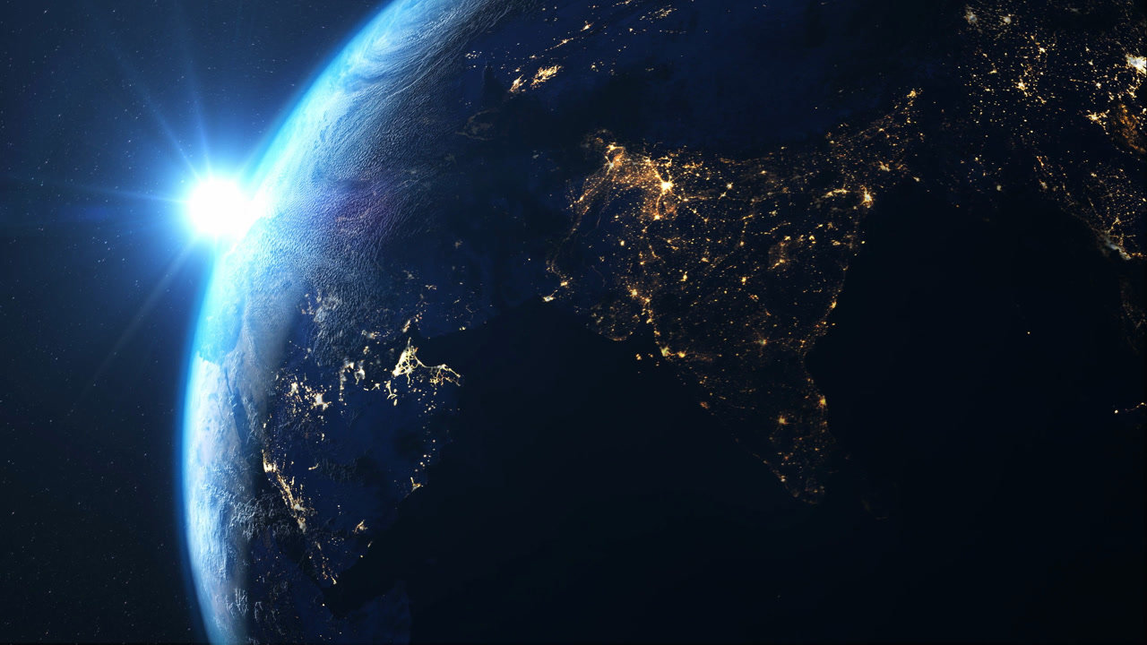

Slide 4
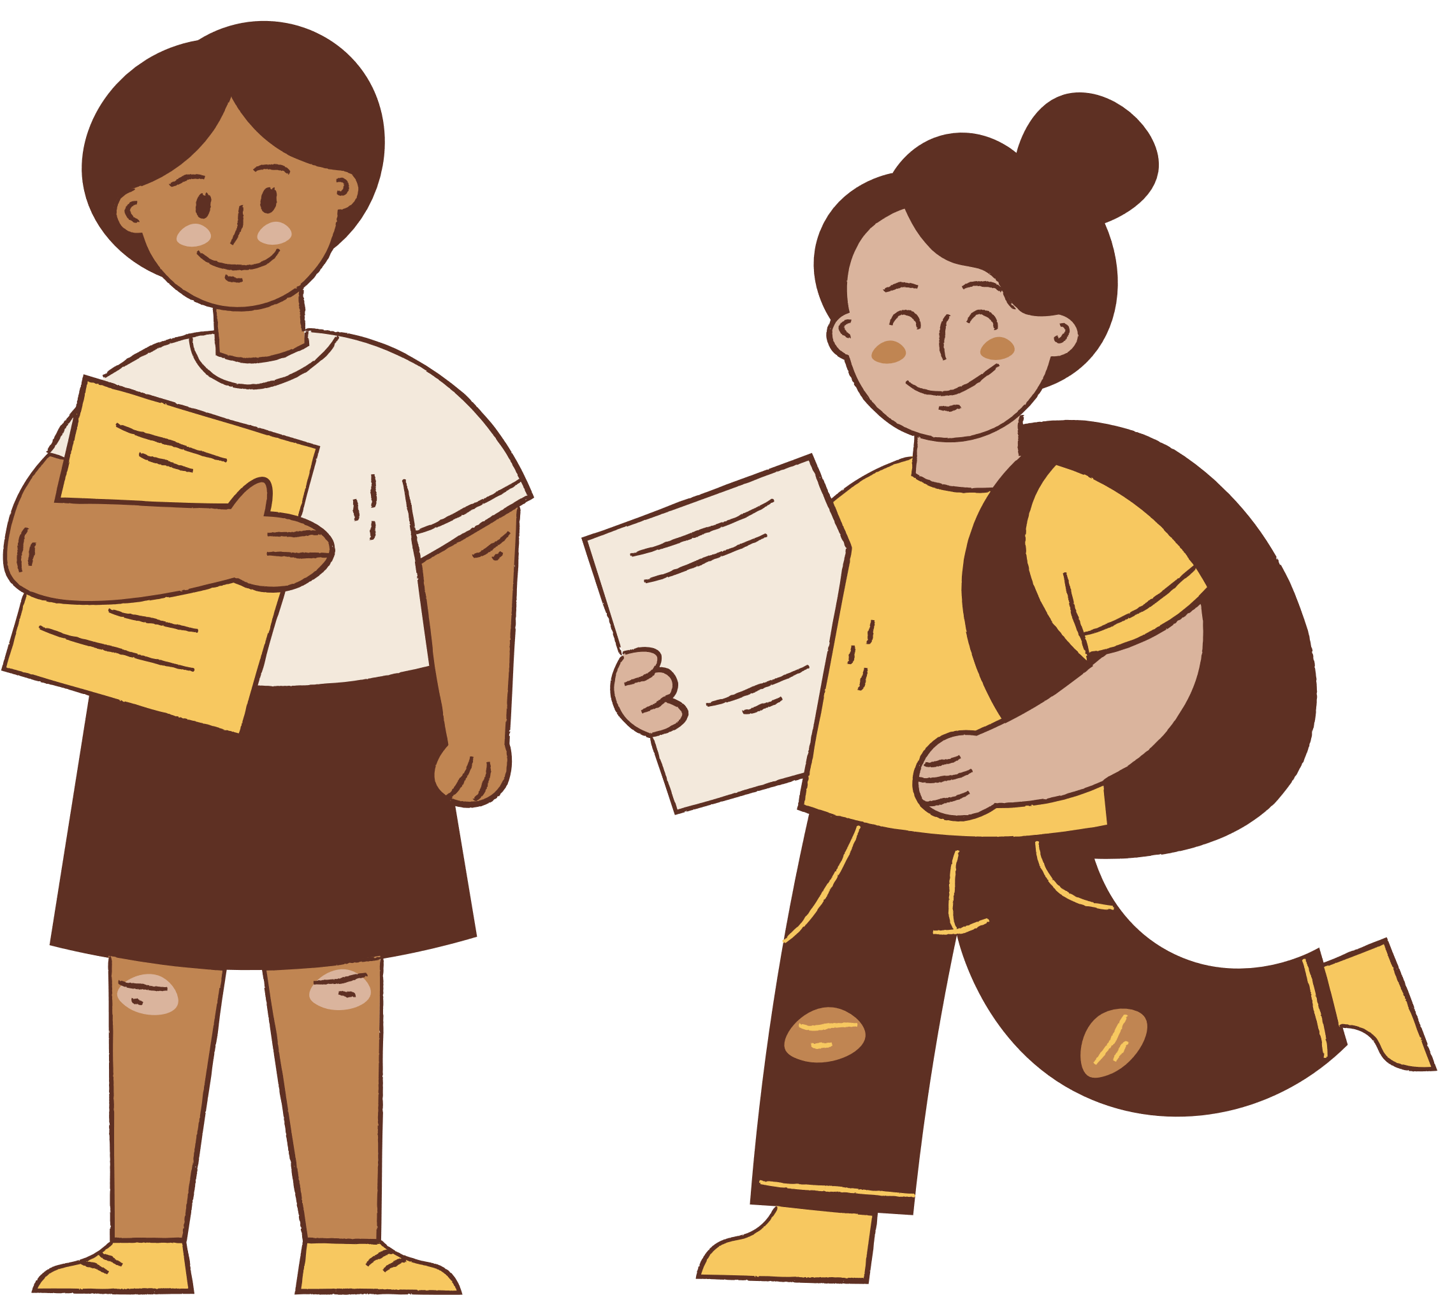
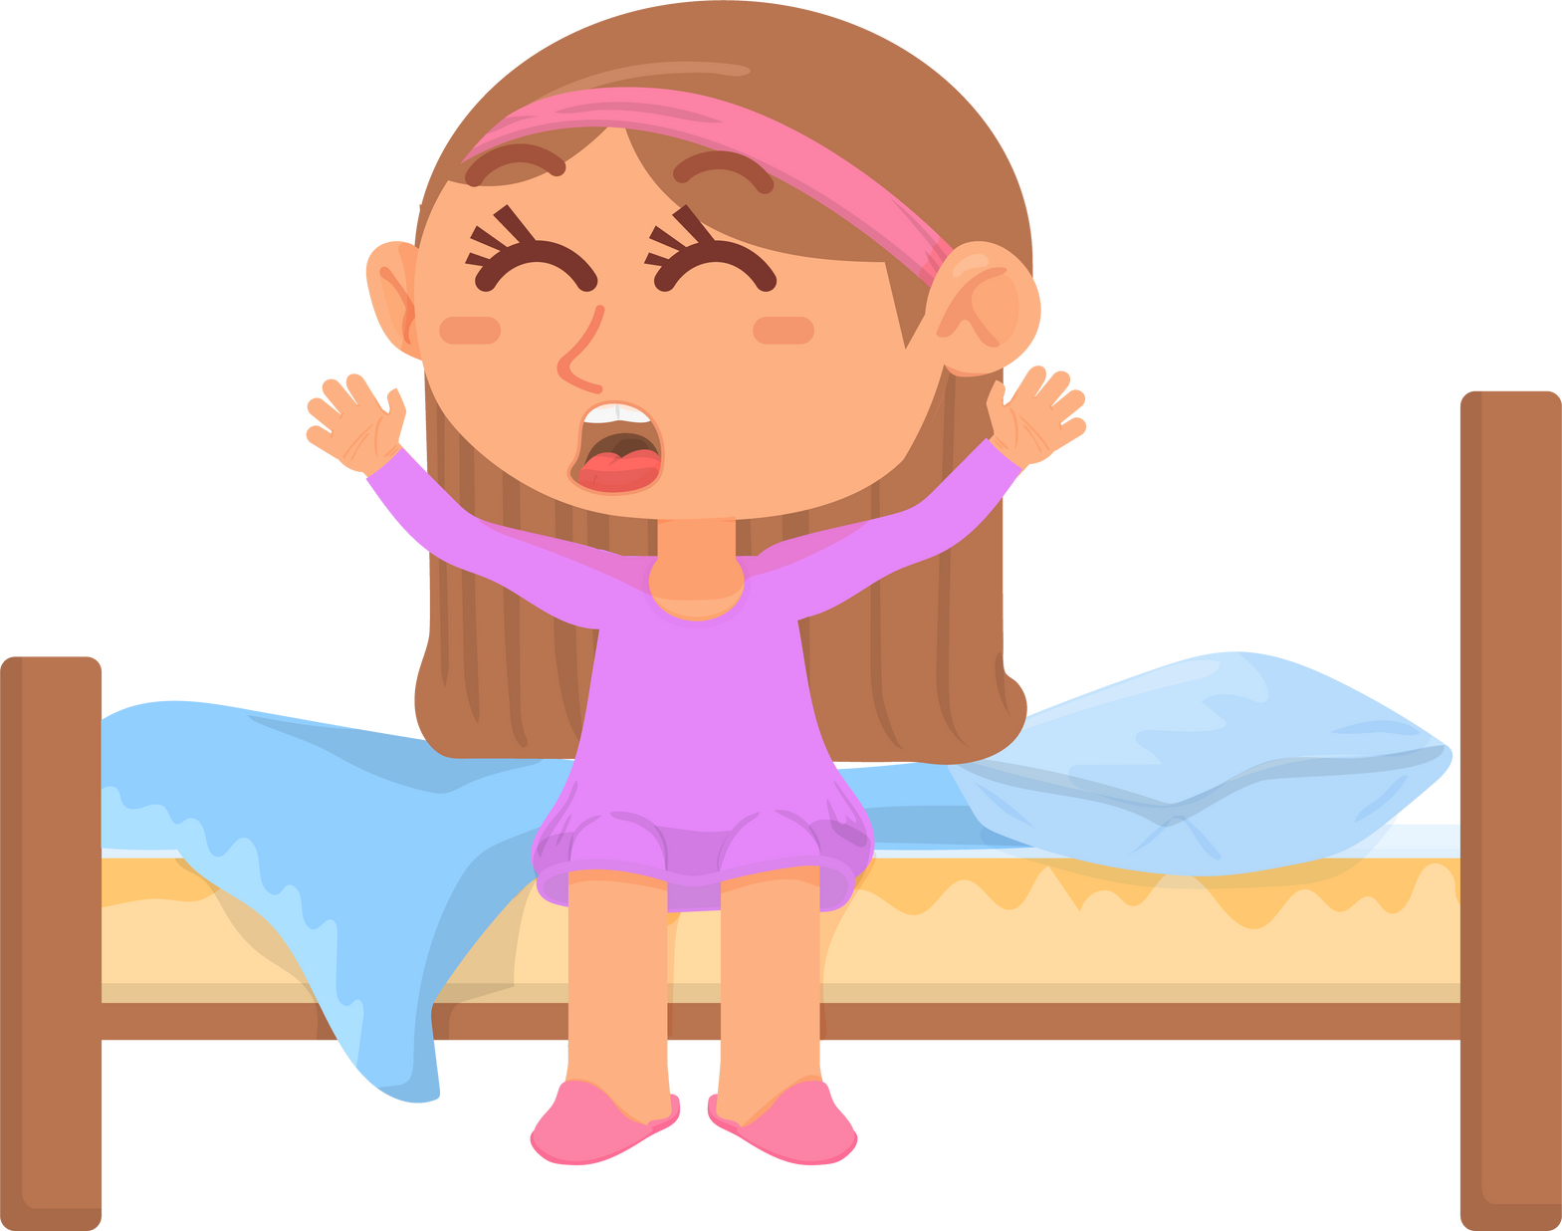

What time of the day do you..
eat lunch?
go to school?
go to sleep?

Slide 5

The Sun
  The Sun is a giant star that shines brightly in the sky during the day. It is like a big ball of very hot gases.
  The Sun gives us light and warmth, making our days bright and helping plants grow.
  It is so big that you could fit more than one million Earths inside it! But don't worry; it is very, very far away from us.
,
  The Sun makes day and night happen. When the Sun is up, it's daytime, and when it's down, it's nighttime.
  We should never look directly at the Sun because it can hurt our eyes. But we can enjoy its light and feel its warmth safely from Earth.

Slide 6

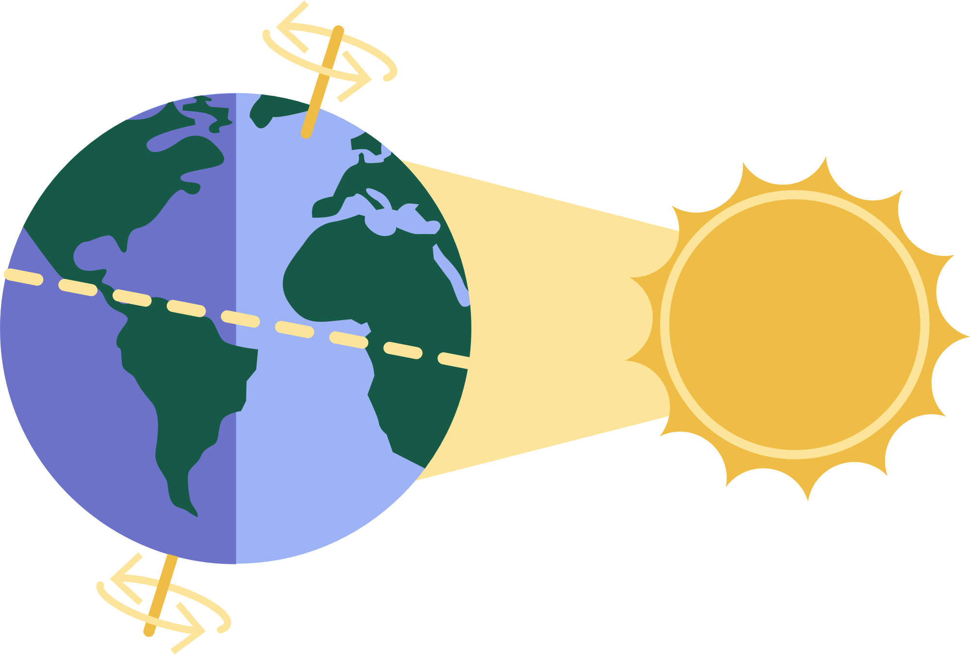
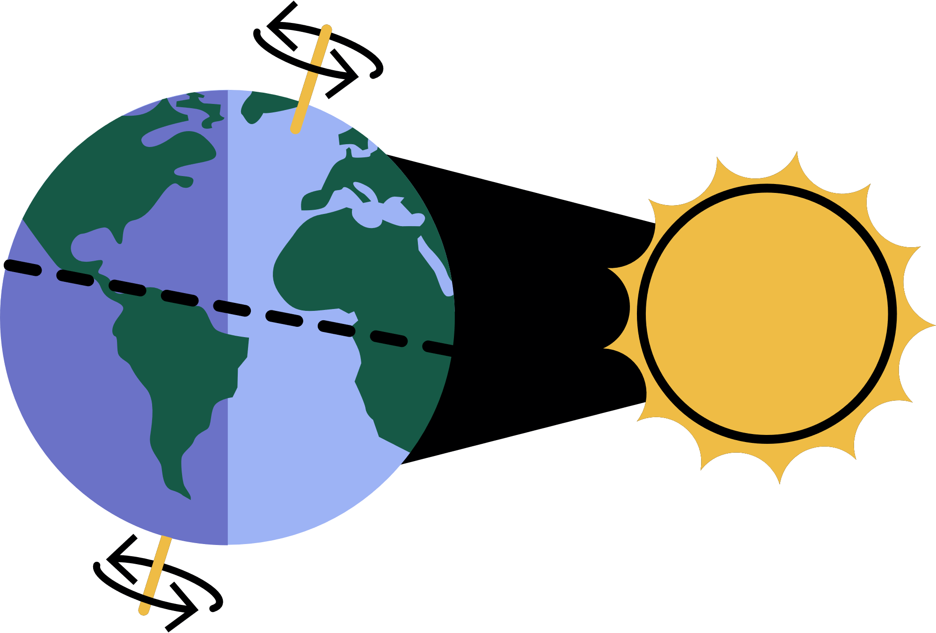

Daytime and Nighttime
Earth takes one day to complete one rotation on its axis.
Areas on Earth facing away from the Sun experience nighttime.
Areas facing the Sun experience daytime.

Slide 7
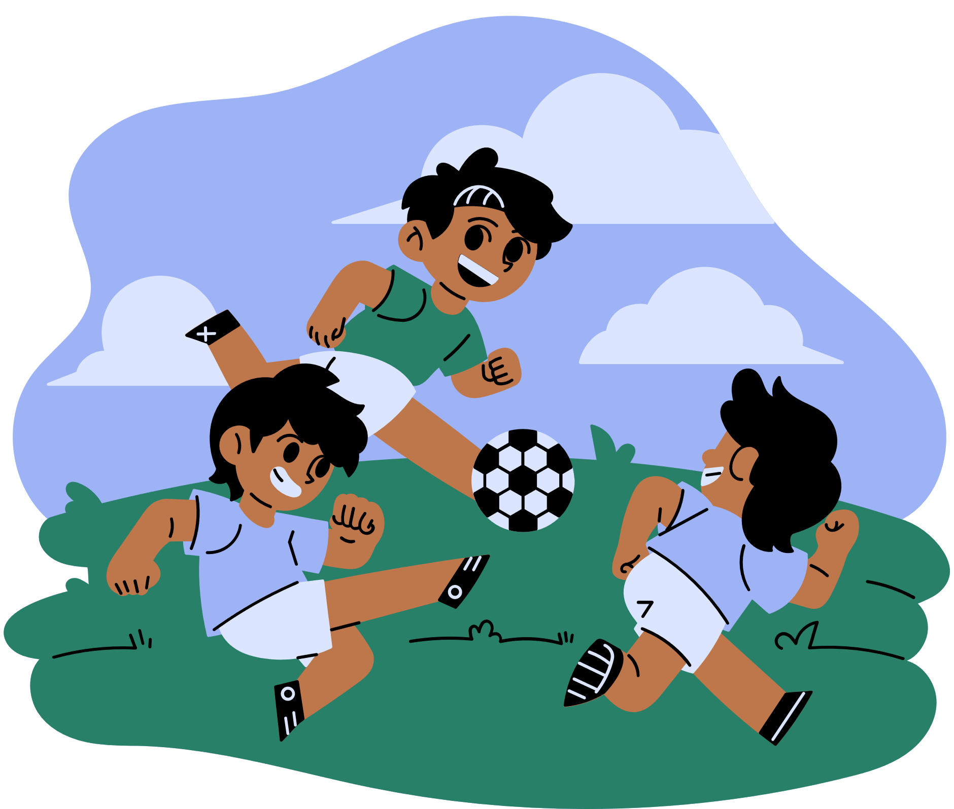
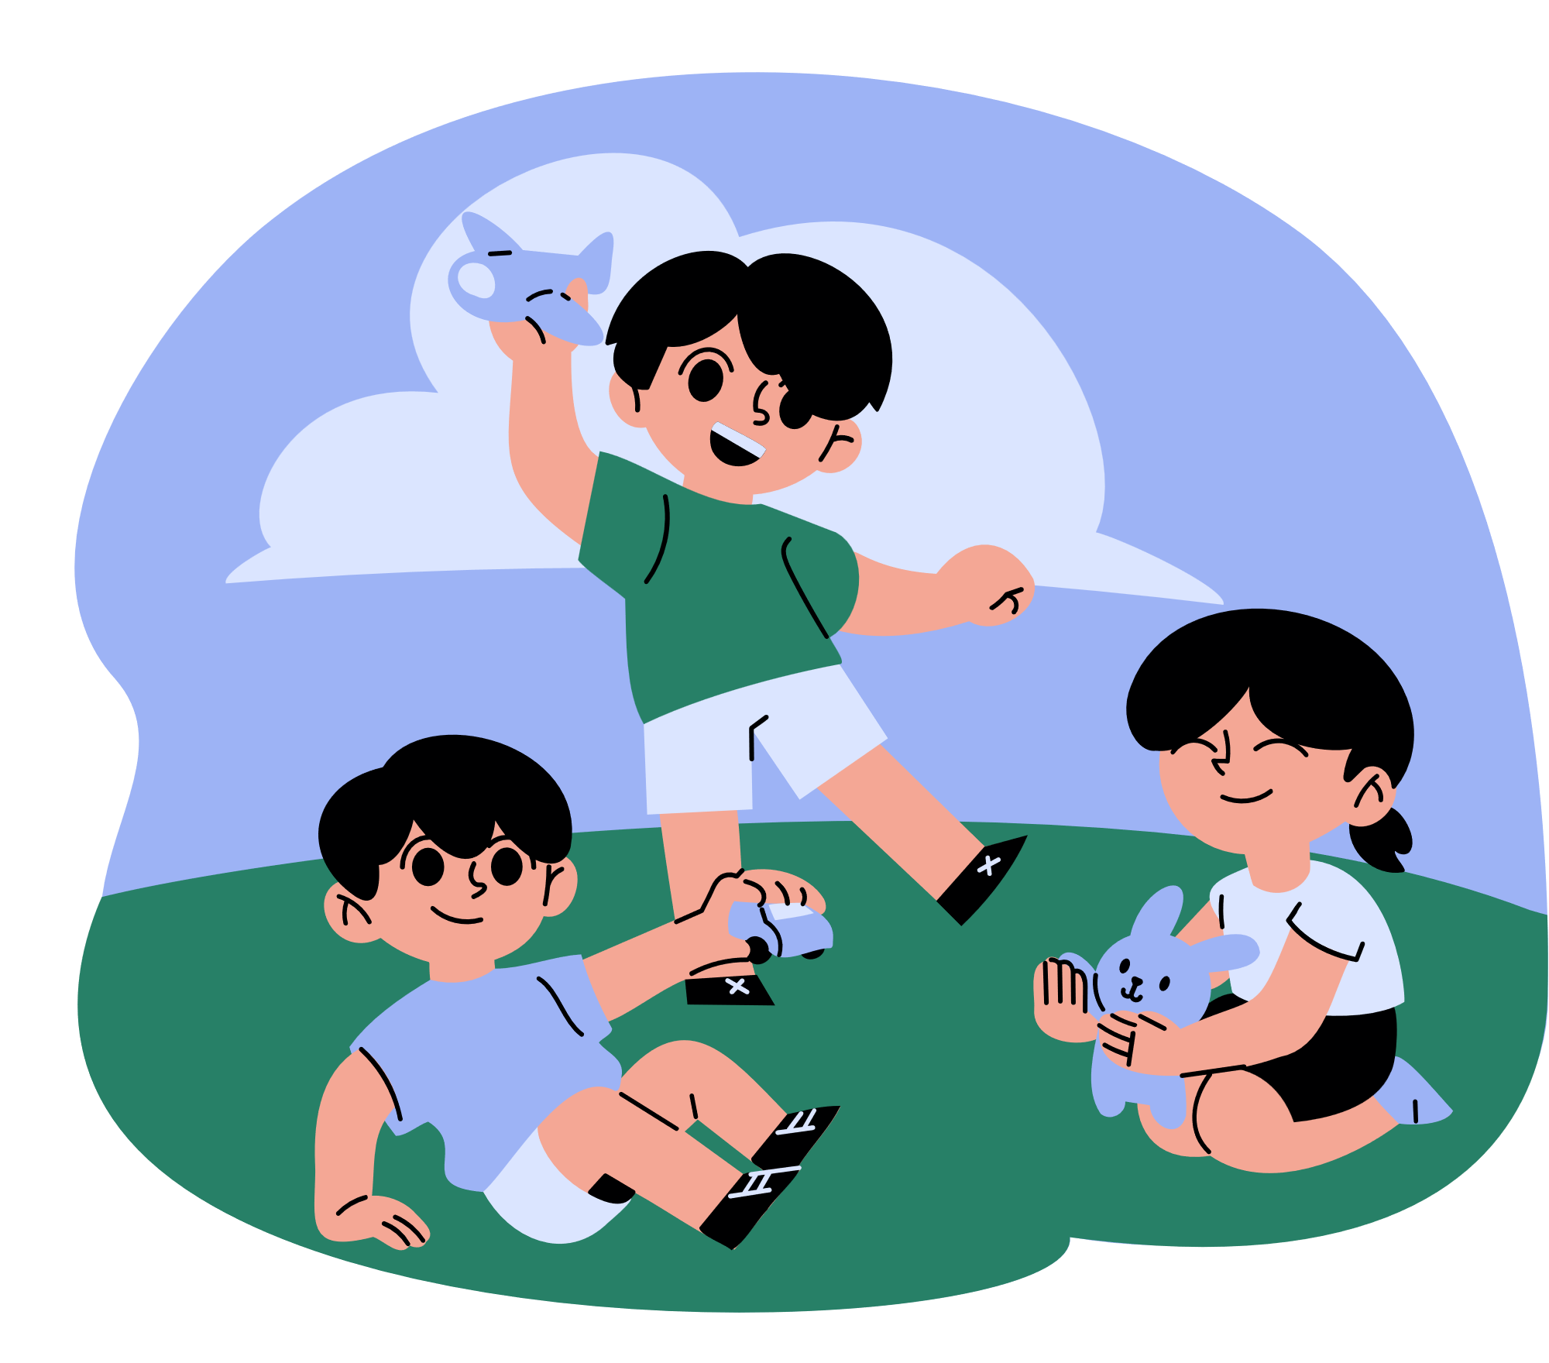
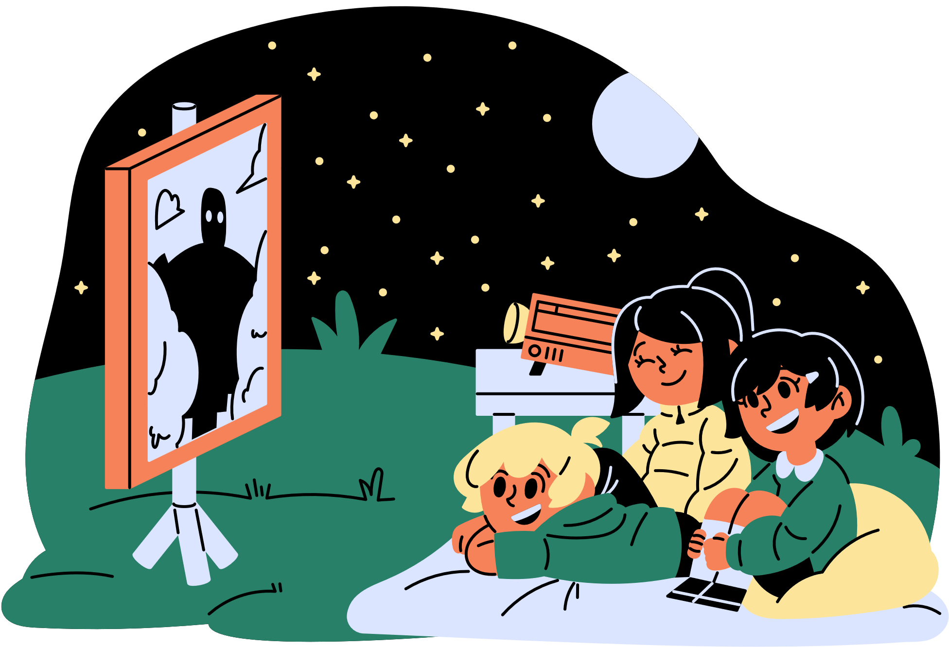
What activities can you do during daytime and nighttime?

Slide 8






2022-1-BG01-KA220-SCH-000085065
School subject: Natural Science
Students’Age: 8 years
Topic: The effects of the Earth's movements and shape on our life
Credits: Antalya Directorate Of Education
All media are within the EU intellectual property law.
The European Commission’s support for this publication does not constitute an endorsement of the contents, which reflect the views only of the authors, and the Commission cannot be held responsible for any use which may be made of the information contained herein.

